Slide 1
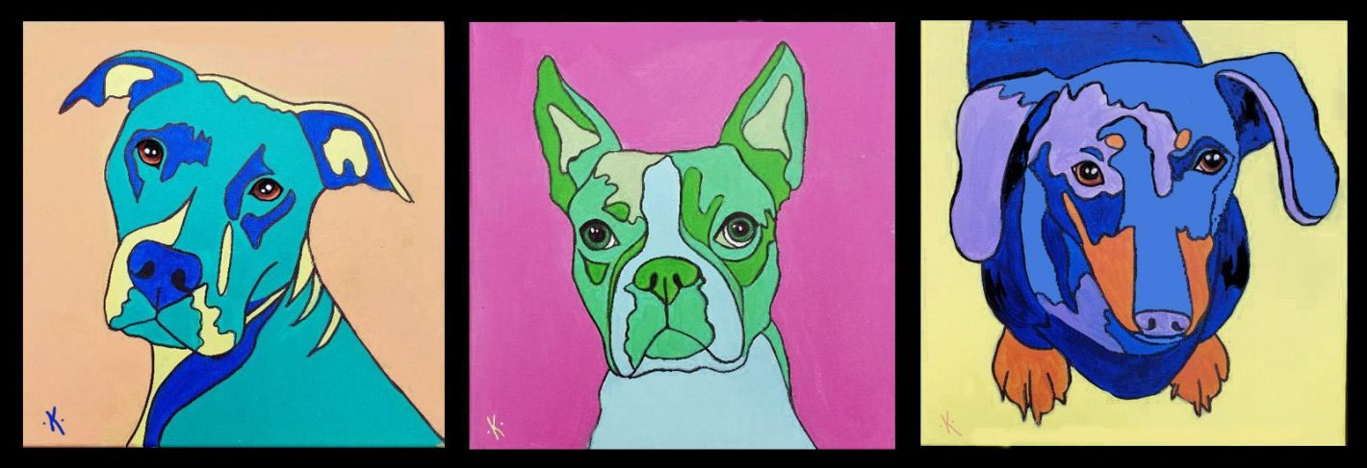
Andy Warhol POP ART
Pet Portraits

Slide 2

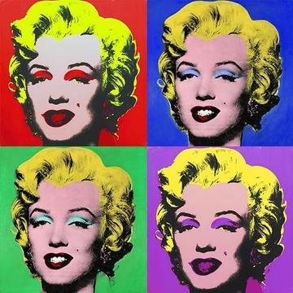
What was POP Art?
Pop Art is an exciting art style from the 1950s and 1960s that takes everyday things we see all the time—like comic books, advertisements, candy wrappers, and soda cans—and turns them into bold gallery masterpieces.
Instead of painting traditional landscapes or portraits, Pop artists wanted to make art fun, bright, and relatable for everyone by using objects from popular culture.

Slide 3
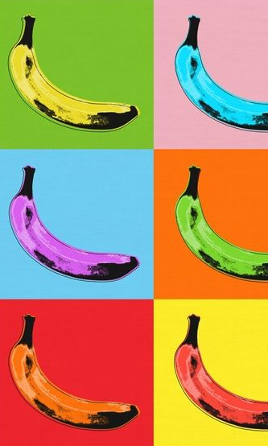
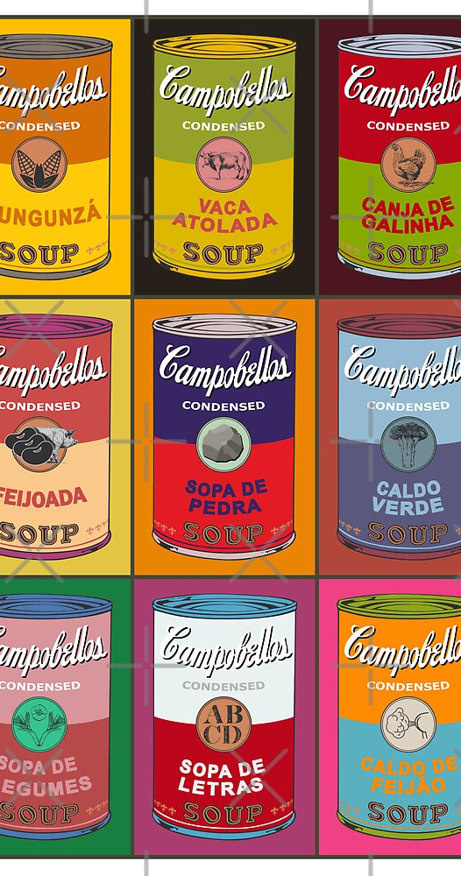
Who was Andy Warhol?
Andy Warhol was the absolute KING of this movement, famous for proving that absolutely anything can be art, even a simple can of Campbell's Tomato Soup.
He used a cool printmaking trick called screen printing to repeat the same image over and over again
By changing the backgrounds to electric neon colors, he turned ordinary items into unforgettable, eye-catching icons

Slide 4
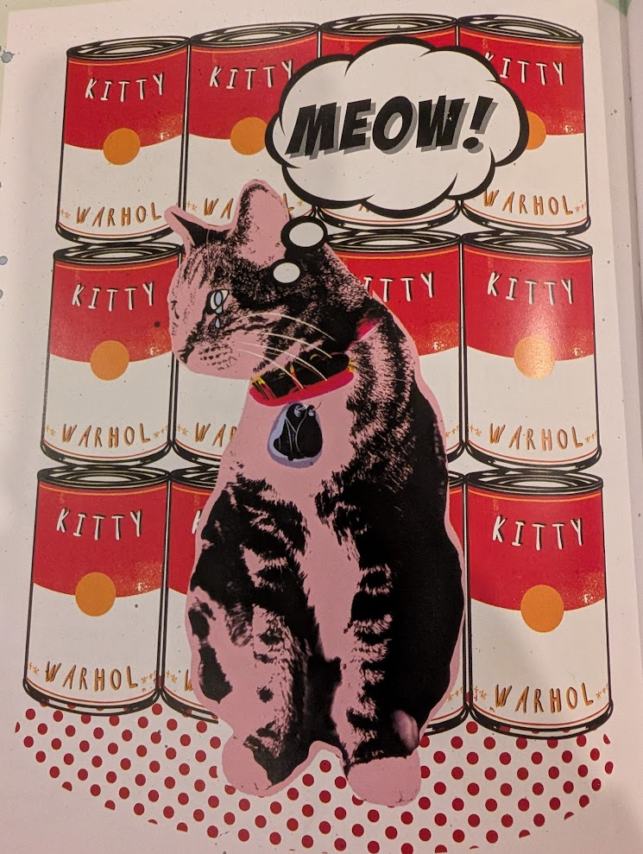
The inspiration…
Bold & contrasting
Bright colours
Repetition

Slide 5

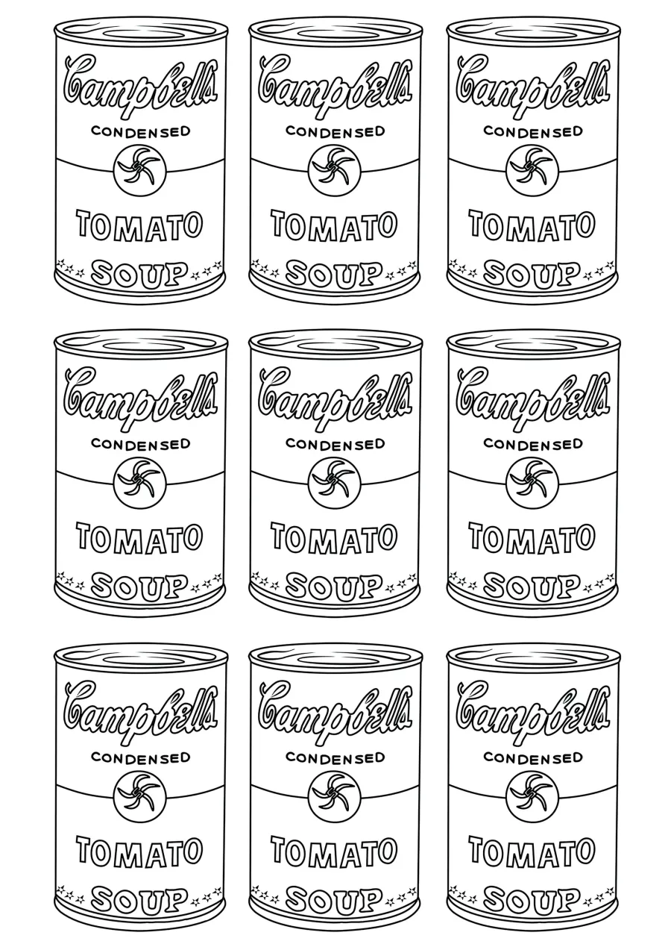
Step 1 Background
Think of an everyday item your pet loves…
Can of food
Dog treat
Yarn
Ball
Toy
Car
What else can you think of?
Trace this item to make a repeating background

Slide 6
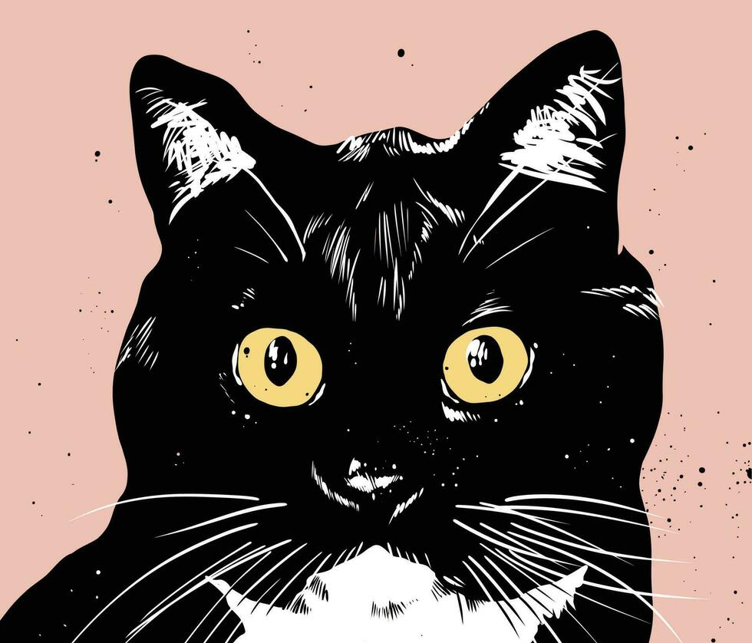
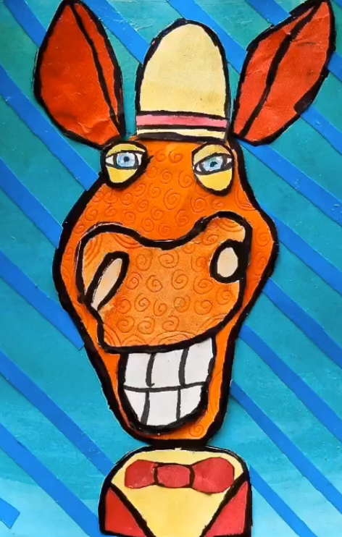
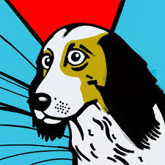
Step 2: Pet Portrait
On a separate piece of paper, draw your pet/ animal of choice.
Make sure you…
Give it lots of personality
Use bold lines
Plan where your colours will go

Slide 7
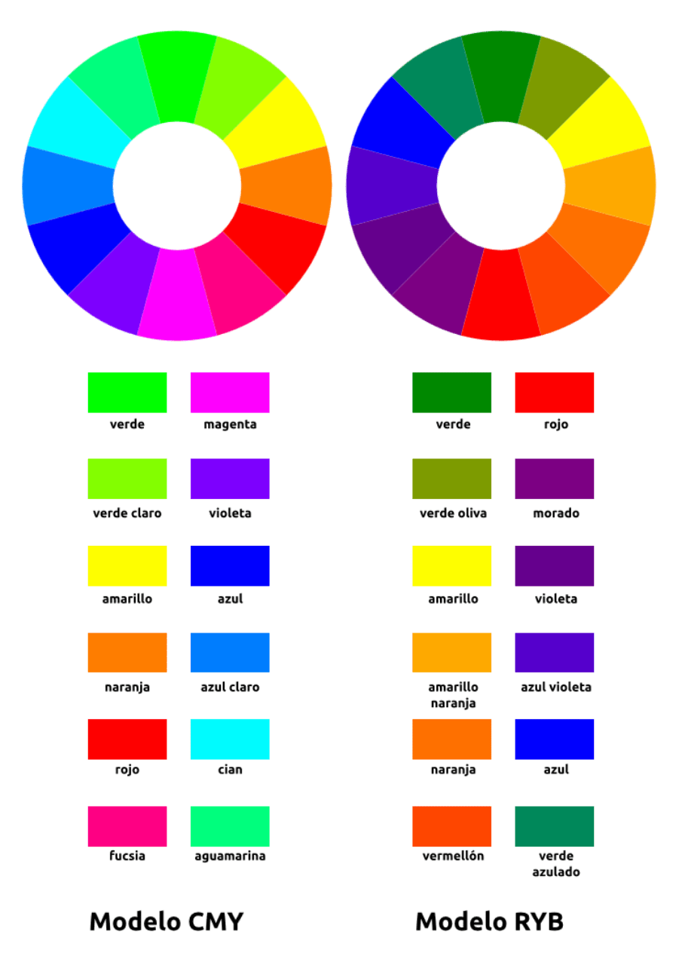
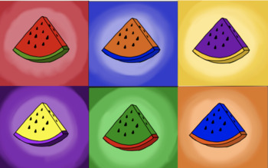
Step 3- Plan your colours
Use bold, bright colours
Choose complementary colours to really make your subject POP from the background.
For example a cool background and warm colours on the subject.

Slide 8
Step 4: Colour, cut, paste
Use paint or markers to create solid, bold, colours
Outline in sharpie/ black
Cut out your pet/ animal
Glue it on the background
VOILA!

